Slide 1

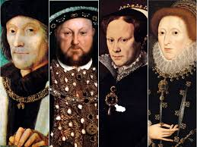
THE TUDORS
Week 11
PGM
From the website Tudor Times

Slide 2
King Henry VI (mentally unstable)
“Wars of the roses”
the House of York the House of LANCASTER
Supports the Duke of York Supports the King
Symbol: White rose Symbol: Red rose
Last battle in Bosworth Field (in 1485)
Richard III (the last Yorkist king) was defeated by Henry VII (Tudor)
became the King; Tudor Dynasty began

Slide 3
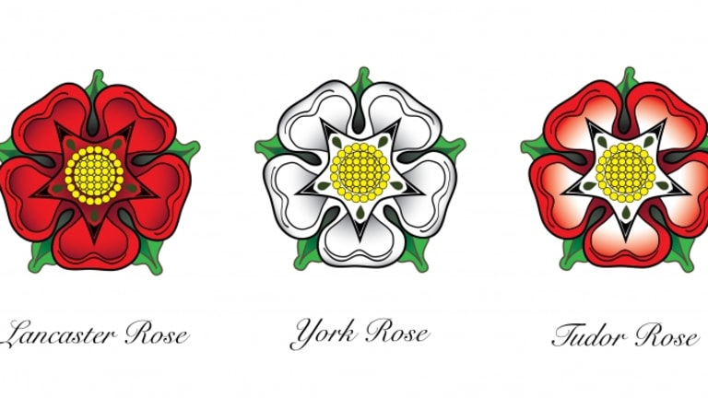
From the website History

Slide 4
tHE TUDORS (1485-1603)
The most glorious period (Renaissance, Reformatıon)
Henry VII (r.1485–1509) built a wealthy nation state
Henry VIII (r.1509–47) made the Church English
Elizabeth I (1558–1603) brought glory to the new state by defeating powerful navy of Spain
(Edward VI (1547-1553)- Bloody Mary (1553-1558)

Slide 5
The Reformation
Henry VIII was always looking for new sources of his money
The Church was a huge landowner, and the monasteries were no longer important to economic and social growth. Many monks started to ignore religious life but lived in wealth and comfort.
.

Slide 6

Henry VIII wanted to centralize the state authority but he had another reason to get rid of Pope’s authority.
Catherine of Aragon: Bloody Mary
Anne Boleyn: Elizabeth I

Slide 7
The Act of Supremacy in 1534
In 1531 Henry VIII persuaded the bishops to make him head of the Church (international organization) in England, and this became law after Parliament passed the Act of Supremacy in 1534
But the break free from Roman Catholic Church was purely political. He did not support Protestantism introduced by Martin Luther in Germany and John Calvin in Geneva.
1532-1536 England became a Protestant country. All the monasteries had been abolished and sold.

Slide 8
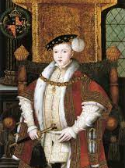
The Protestant-Catholic struggle
Edward VI ruled the country by a council.
In 1552 a new Prayer Book was introduced to make sure that all churches followed the new Protestant religion. (They had been glad to see the end of some practices like the selling of pardons
From the website Word Press

Slide 9
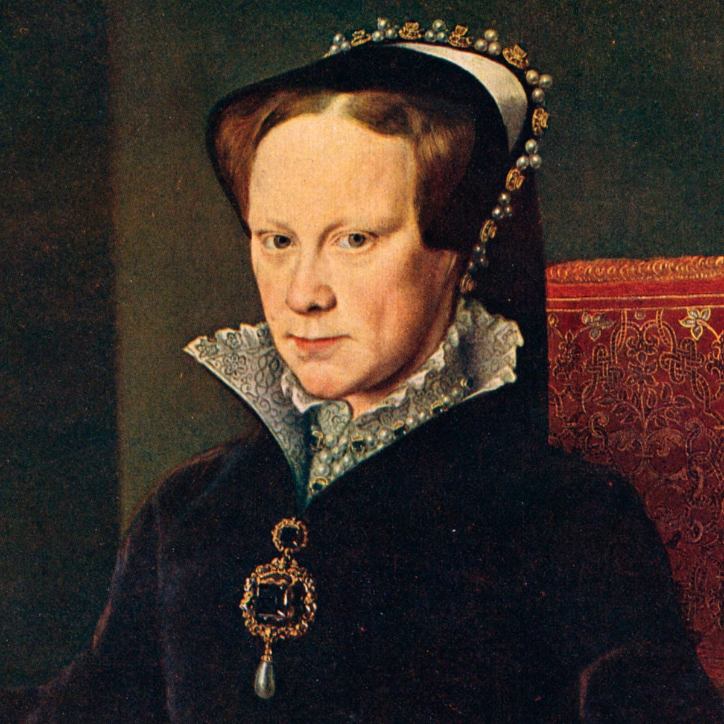
Mary became queen when Edward died in 1553.
Mary got married to King Philip of Spain, accepted as the king of England for Mary’s lifetime.
She then began burning Protestants.
From the website History

Slide 10
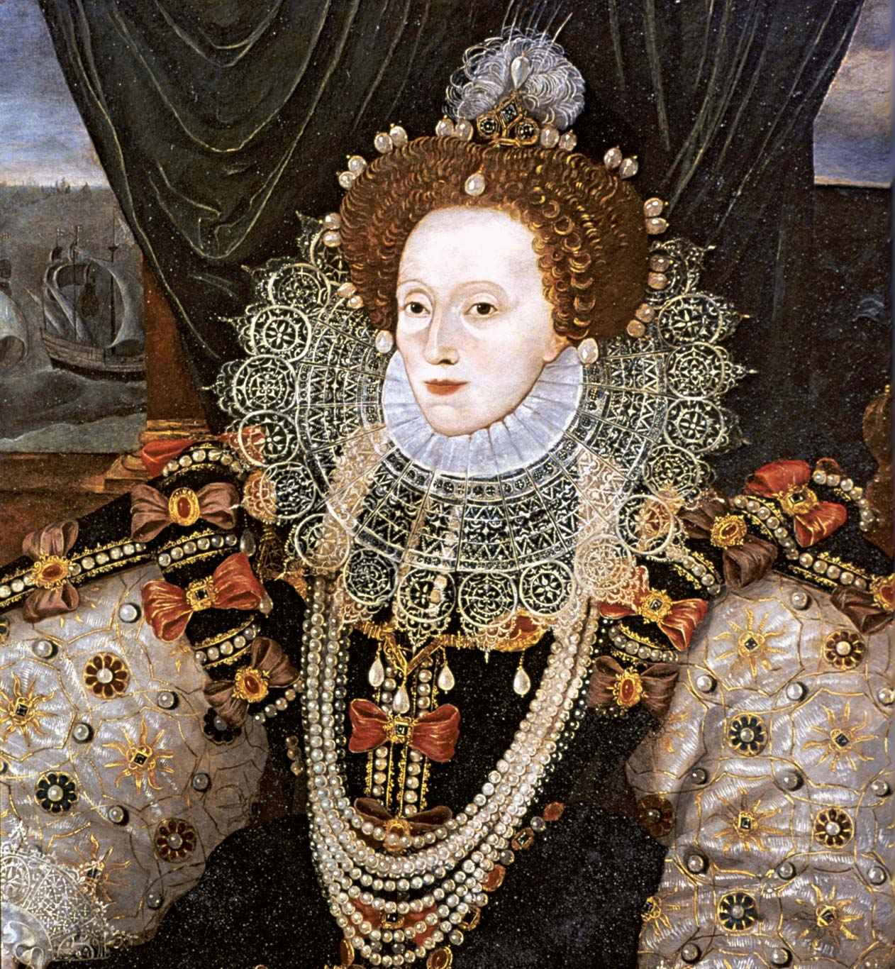
Elizabeth became queen (1558-1603) when Mary died in 1558.
the kind of Protestantism finally agreed in 1559 remained closer to the Catholic religion than to other Protestant groups
From the website Biography
Notes:
wanted to bring together again those parts of English society which were in religious disagreement. And she wanted to make England prosperous.
But Elizabeth made sure that the Church was still under her authority, unlike politically dangerous forms of Protestantism in Europe. In a way, she made the Church part of the state machine.

Slide 11
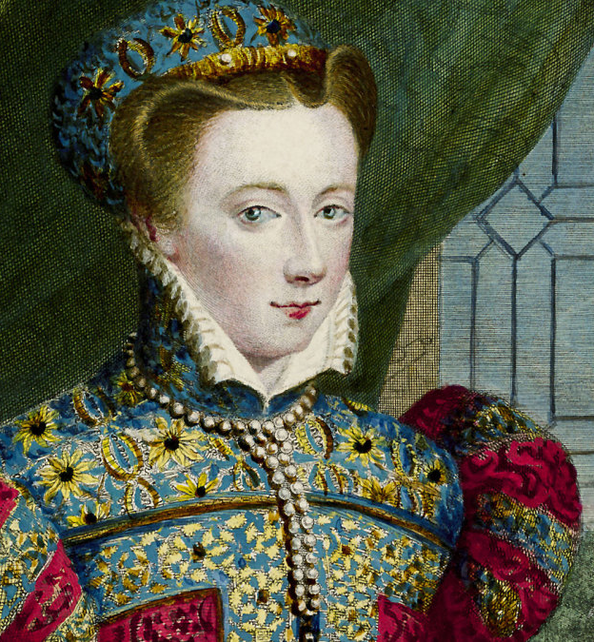
Mary, the Scottish queen, usually called «Queen of Scots,» ruled Scotland; she was Catholic.
France and Spain supported Mary since they wished to make England Catholic again.
From the website History

Slide 12
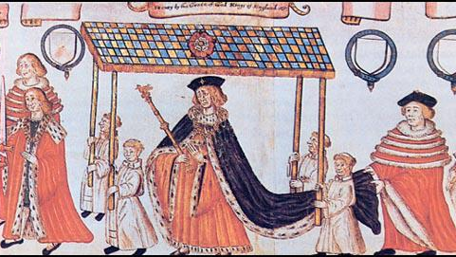
Tudor Parliaments and Justice
From the website Spartacus Educational

Slide 13
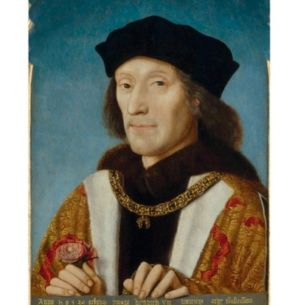
Henry VII had used Parliament only for law making; he used the "Court of Star Chamber," traditionally the king's council chamber, to deal with lawless nobles.
Henry encouraged the use of heavy fines as punishment because this gave the Crown money; raised taxes for wars which he then did not fight.
From the website History Extra

Slide 14
Henry VIII assembled Parliament to make the laws for Church reformation.
The Catholic Queen Mary succeeded in making Parliament cancel all the new Reformation laws.
Elizabeth tried not to use Parliament after her Reformation Settlement of 1559, and in forty-four years she only let Parliament meet thirteen times.

Slide 15
Only two things persuaded Tudor monarchs not to get rid of Parliament:
    they needed money
    they needed the support of the merchants and landowners

Slide 16
Until the end of the Tudor period Parliament was supposed to do three things:
    agree to the taxes needed;
    make the laws which the Crown suggested;
    advise the Crown

Slide 17
MPs were given important rights:
    freedom of speech
    freedom from fear of arrest
    freedom to meet and speak to the monarch

Slide 18
Economy and Society
As the 15th century came to a close, the rate of population growth began to increase.
    Year Population total in millions
    1525 2.26
    1541 2.77
    1551 3.01
    1561 2.98
    1581 3.60
    1601 4.10
    (Source: E. A. Wrigley and R. S. Schofield, The Population History of England, 1541-1871, London, 1981)

Slide 19
Many landowners could sell the wool for a good price to the rapidly growing cloth industry.
In order to keep sheep they fenced off land that had always belonged to the whole village.
Between 1500 and 1540, prices in England doubled, and they doubled again in the next generation

Slide 20
By using coal instead of wood fires, they learnt how to make greatly improved steel.
Coal became the most commonly used fuel, especially in London.
Chimneys were now built in every house.

Slide 21
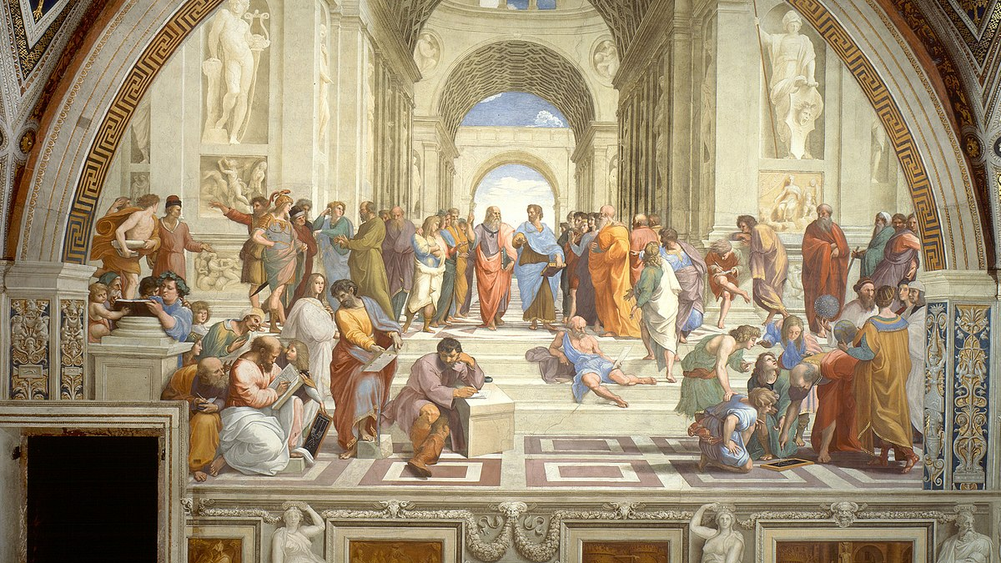
Renaissance
From the website Wikipedia

Slide 22
Where and when was the Renaissance?
The term ‘Renaissance,’ cultural renewal, refers to a profound and enduring upheaval and transformation in culture, politics, art, and society in Europe between the years 1400 and 1600.
It was the rebirth of intellectual and artistic appreciation of Graeco-Roman culture.

Slide 23
Renaissance Humanism
The humanists, of whom the greatest was Erasmus of Rotterdam (1467-1536), rejected scholasticism in favour of simple biblical piety, or philosophic Christi, which was founded on primary textual scholarship, and in particular study of the Greek New Testament.

Slide 24
This was a time when a whole generation of intellectuals developed a new method of learning derived from classical Greek and Roman authors, called studia humanitatis.

Slide 25
Humanism’s success lay in its claim to offer two things to its followers.
  First, it fostered a belief that the mastery of the classics made you a better, more ‘humane’ person
  Secondly, it convinced students and employers that the study of classical texts provided the practical skills necessary for a future career

